Slide 1



Presentation for G9-3 (C915) – Project 3
By Emiljano Bodaj, Nabila Ahmed, Jason Brandwein, Juhao Chen, Lin Chen, Danny Mancheno

Slide 2
Group Members Task
Emiljano Bodaj – Project Manager, Gantt Tracker, JDBC + Video, Database Construction
Nabila Ahmed – Associate Manager, Database Reconstruction
Jason Brandwein – JDBC, Database Construction
Juhao Chen – Presentation Related task, Database Construction
Lin Chen – Presentation Related task, Database Construction
Danny Mancheno – Video Editor (Adobe Premier), Database Construction

Slide 3

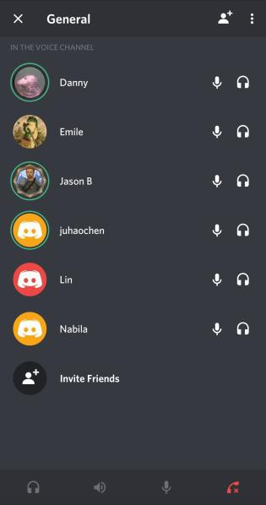
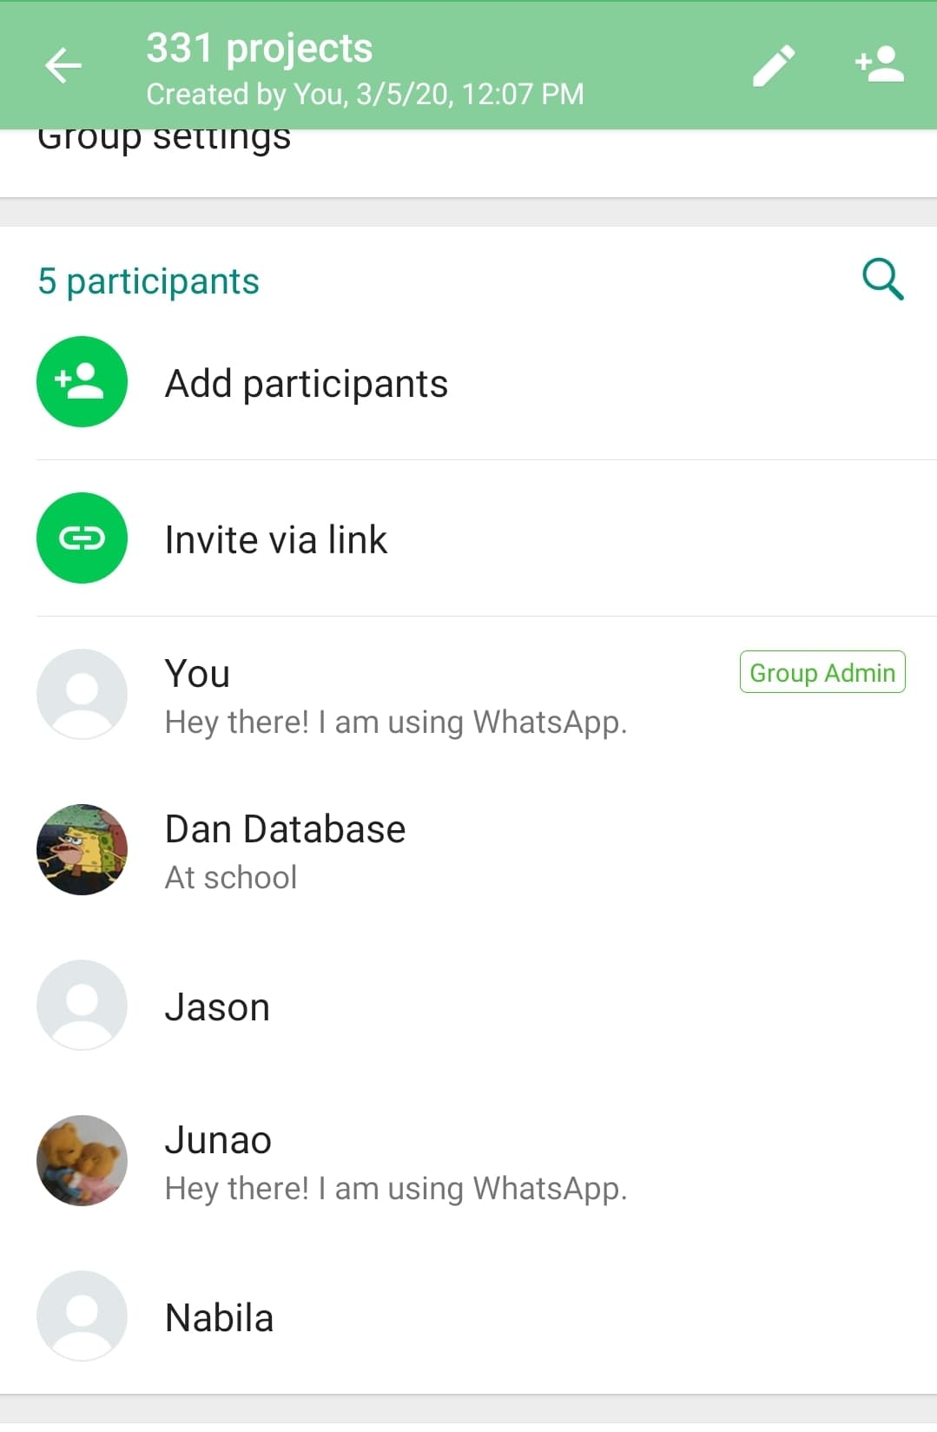
Group Meetings
Group Meeting One
Agenda:
Divide the work among all group members.
Ask the group members to plan out their to-do list and have it ready by next meeting
Set a date for the next group meeting
Set up google group and a drive so everyone can submit their work.
Interpreting the project’s specifications
Group Meeting Two
Agenda:
Go over the members to-do list and the team’s Gantt Tracker.
Answer any questions a member might have regarding the project’s requirements and objective.
Set a date for the next group meeting via Zoom or Discord.
Average meeting was approximately 30-40 minutes.

Slide 4
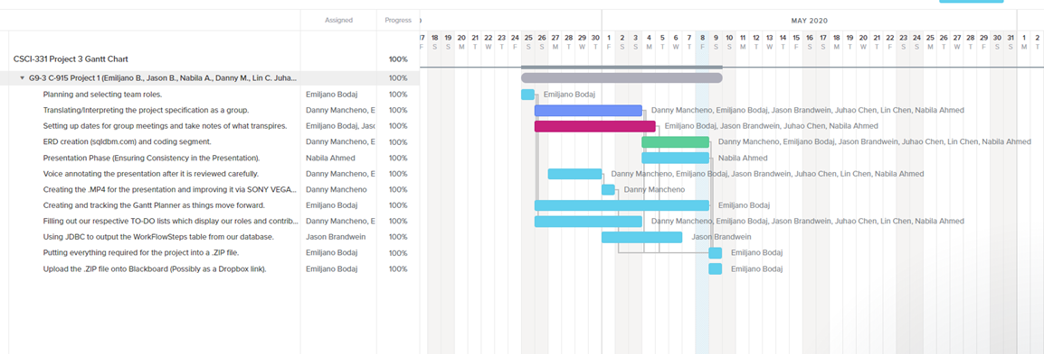
Finalized Project 3 Gantt tracker (G3-9)

Slide 5
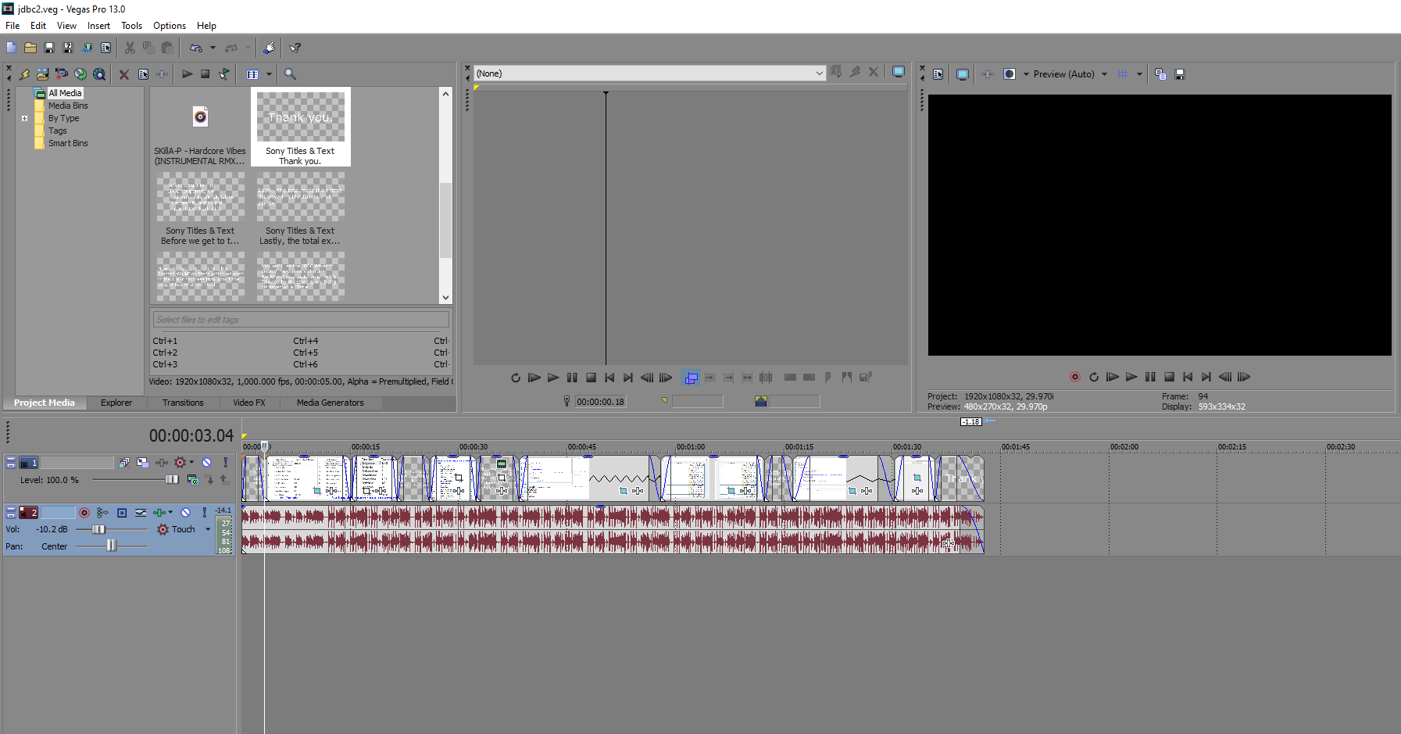


For Video Editing
Sony Vegas (Emiljano Bodaj) and Adobe Premiere (Danny Mancheno) were utilized for
the project. These services were used specifically for the JDBC video and presentation
.MP4, respectfully.

Slide 6
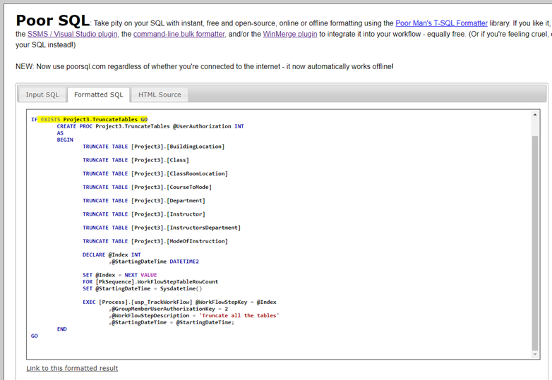
POORSQL.COM is once again utilized for proper formatting

Slide 7
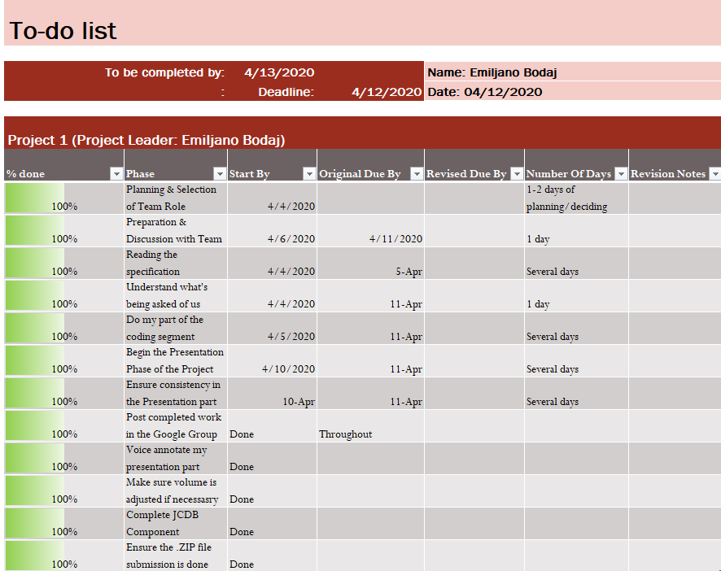
To-do List for Emiljano Bodaj

Slide 8
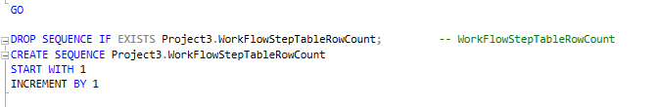
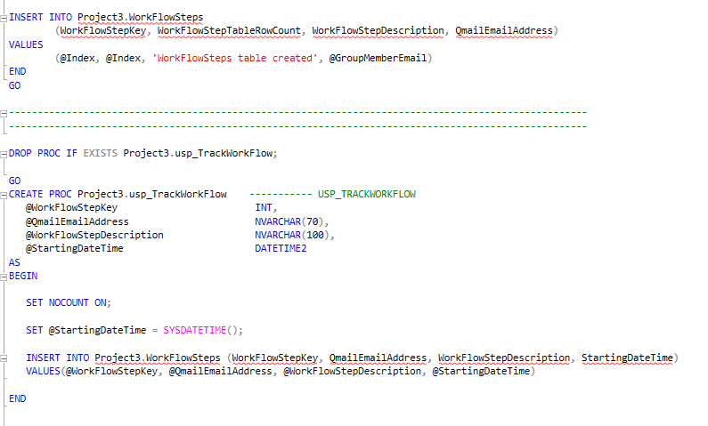
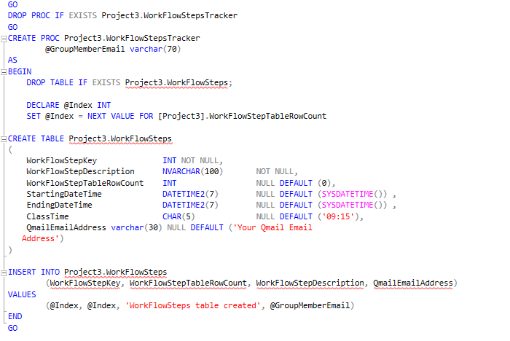
Creating the Project3.WorkFlowStepTableRowCount, Project3.WorkFlowSteps table,
and Project3.usp_TrackWorkFlow procedure

Slide 9

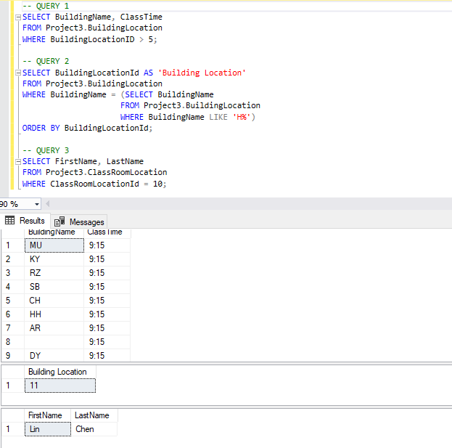



3 Queries by Emiljano Bodaj using this database.

